Slide 1
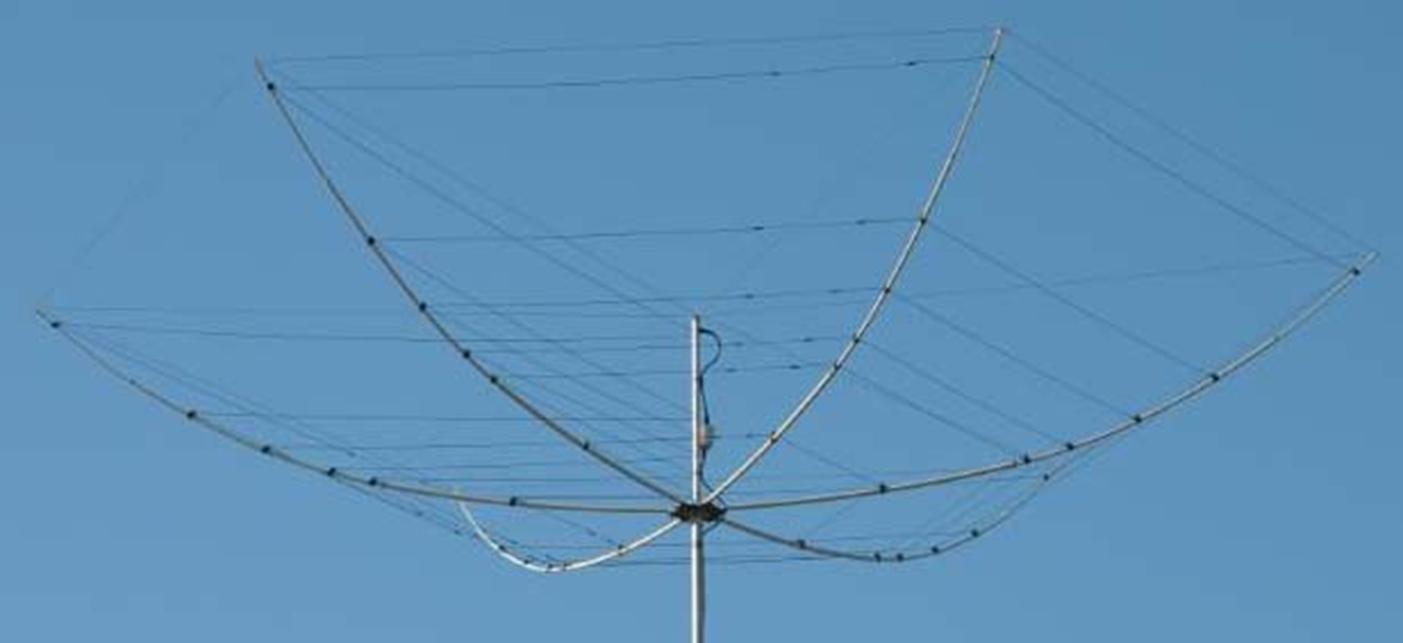
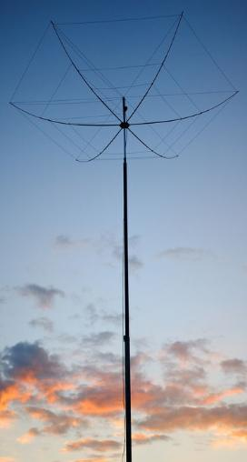
South Mountain Radio Amateurs Hex Beam Antenna is a modified Yagi antenna; how well does it work? 17-march-2026 jerry sodus..km3k
K4KIO Six-Band Hex Beam
Six Band G3TXQ HD Hex Beam by MW0JZE
Mike Traffie invented the Hex Beam; G3TXQ improved it in 2007. His re-design is more broadbanded and usable without a tuner; it is now the basis for all manufacturers.
General disclaimer: I have no interest in any company mentioned in this presentation.

Slide 2
Road-map…
The two electrical parts of a “Hex Beam” (Yagi) antenna and its “directivity”.
First a “four slide” crash course on the “Yagi” antenna; some basic facts.
The dipole is the “driven-element.
The “parasitic-elements”.
What is a Yagi good for?
Now for the “Hex Beam” (Yagi) antenna and its two parts; also “directivity”.
#6a. To explain all those wires. #6b. A look at a VHQ center-post and connections there.
It is useful to look at the specifications for a hex beam antenna.
Performance data for a hex beam antenna (from K4KIO website).
Why “free space” seen on earlier slides?
#10a. Explaining why the transmitted signal goes in a concentrated direction. #10b. How it works; a different look; this is copied, with editing, from K4KIO.
A look at the Hex Beam’s Gain, Front-to-Back ratio (F/B), SWR; we can compare it to a standard yagi.
Compare hex beam to dipole performance.
Talk a bit about mounting height and other considerations about robust construction.
Balun.
A look at some USA manufactures with $$$ too.
Why a Hex Beam?
https://www.k4kio.com/hex-ed-articles/.
Bibliography. (There are nine slides included at the end that are not part of this presentation…slide-22 to slide-30.)

Slide 3
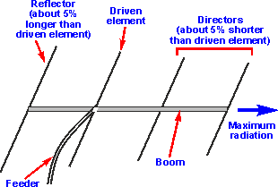
#1. First a “four slide” crash course on the “Yagi” antenna; some very basic facts.
1. The Yagi has to have at least two parts: a driver and a reflector.
This is a picture of a 4-element Yagi. It has: a driver, a reflector,
and two directors.
2. A normal Yagi has a metal boom for structural strength; a boom, for 20m, can be quite long (6’, 20’, 40’).
3. The driver is a dipole antenna; so you know it has two pieces and is fed in its middle. These two pieces are “electrically isolated” from the metal boom. The driver does the “main” radiating; much more will be said later about this. Since it is a dipole, the driver must be a “half-wavelength long”. So, for the 20m band (65.6 feet), a “half-wavelength” is 32.8 feet long, which means each piece is 16.4 feet. In actual practice, the driver is a tad bit shorter. 3a. A Yagi can also have additional parts called directors; see picture’s comments. 3b. The reflector and all directors are connected electrically to the metal beam; a short-circuit.

Slide 4
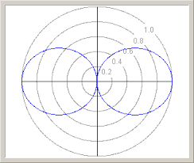
#2. The dipole is the “driven-element”.
DIPOLE
With only the dipole on the boom, it would have this basic, classic dipole radiation pattern.
The Yagi antenna design has a dipole as the “main” radiating or driven-element. Since it is a dipole, it has two conductive metal parts. Keep in mind that a dipole is just a transmission-line spread apart.
The “driven-element” must be electrically isolated from the conductive metal boom.
The feeder is attached to that “driven-element”; a yagi’s impedance is low…10 to 40 ohms.
A dipole is balanced; so, if coax feed is used, it must be fed thru a “balun”, which is a simple device to change a coax-cable’s unbalanced-feed to a balanced-feed.

Slide 5
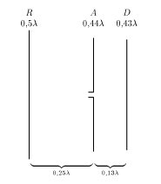
#3. The “parasitic-elements”.
Here are shown some possible spacings. The lambda symbol λ is the wavelength.
‘Parasitic-elements’(reflector and directors) are not directly connected to the driven element.
What is different here is each parasitic-element is one solid conductive metal piece and is directly connected to the metal boom; this greatly simplifies mechanical details.
The reflector element has the most “bang for the buck”; you have about 4.5dB gain. This means that a 100 Watt signal can look like 281 Watts. If you have just the reflector and a driven-element, you have a “two-element yagi”.
Roughly speaking, the first director adds 2dB gain, so the 281 Watts gets to 444 Watts. But each additional director adds only 1dB at the expense of greatly lengthening the boom, which adds enormous size and weight to be handled by the rotor and tower.

Slide 6
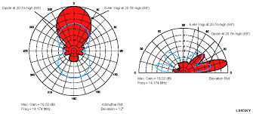
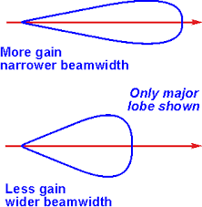
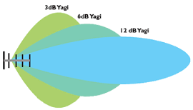

#4. What is a Yagi good for?
1. The Yagi’s most attractive feature is its directivity. It is able to “re-direct” most of the RF energy into a desired direction. It is not an amplifier, so it does not create gain.
2. Reduces QRM (man-made noise) from other directions making receiving easier. Also has gain for receiving due to reciprocity.
3. Has a decent low “take-off” angle for DX.
Only the major lobe is shown.

Slide 7
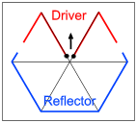
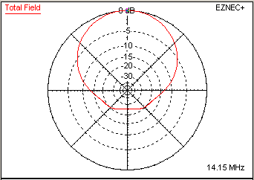
#5. Now for the “Hex Beam” (Yagi) antenna and its two parts; also “directivity”.
top view
1. The Hex Beam has only two electrical parts; the Driver and the Reflector. So the Hex Beam is a basic “2-element Yagi”. 2. The Hex Beam design warps the Driver to “M” shape and the Reflector to “U” shape to compress the overall size. 3. There is no boom. 4. The highly desired directivity is maintained. 5. Notice the Reflector is not split in its middle. The wire really is a “short-circuited transmission-line”. (For more details, see slide-28.)
top view
In March-2024, I gave a presentation to the club on Yagi-antennas. The material to the left was used in that work. The web address I used to get it is no longer active in year-2026 for ham-radio; when I was preparing for today, it took me to a gambling website.

Slide 8
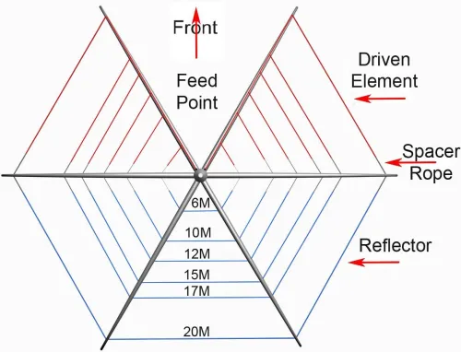
https://wa4nzd.wordpress.com/2014/10/15/hexagonal-beam-antenna-presentation-by-rob-conklin-n4wgy/
#6. To explain all those wires.
Top View
The driver wires on the left side each connect individually to the center post (Feed-Point).
Likewise for the right side. Do you recall the wire lengths of the 20m Yagi?? Reflector is ~32.8’
Driver Elements are ??
The hexbeam is fed with 50-ohm coax.
20M
20M
17M
17M
Notice the reflectors are not split in the middle. Technically, it is a “short-circuited transmission-line”.

Slide 9
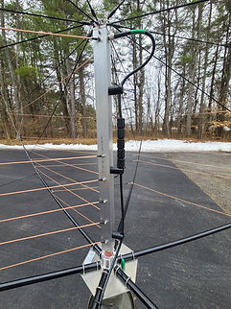
#6b. A look at a VHQ center-post and connections there.
Starting at the top: 1. Support rods to the “spreaders”; two per spreader (top and half-way). 2. Coax feed. 3. Notice the ferrite-bead balun. 4. Connections for the six drivers 20m, 17m, 15m, 12m, 10m, 6m. 5. Take note how the “spreaders” are secured at the base-plate. 6. Just above the base-plate, see the pinkish item. VHQ makes a BIG deal about that piece not failing. Lifetime warranty all their parts. 7. VHQ would not tell me what is inside the center post.

Slide 10
#7. It is useful to look at the specifications for a Hex Beam antenna.
(copied from the K4KIO website for their hex beam antenna)
Specifications
Bands 20, 17, 15, 12, 10, 6 meters
Antenna elements 2 per band
Gain (free space) Peak Approx. 5.4 dBi (Next slide has gain over ground by band)
Front/Back (free space) Peak >10 dB, (See. below for F/B by band)
VSWR Less than 2:1 across nearly all bands
Feed line 50 ohms, single coax cable for all bands
Turning Radius 10.8 Ft (3.3m)
Diameter of the beam 21.6 Ft (20M beam), 16.6 Ft (17M beam), 15.0 Ft (15M beam)
Height of the beam 39 in. (99 cm) from base plate to top of center post
Weight 26 lbs (11.3kg)
Wind Load Area 5 Sq Ft (0.46 sq m)
Power 2,000 watts P.E.P.
Mast requirement Several mast sizes

Slide 11
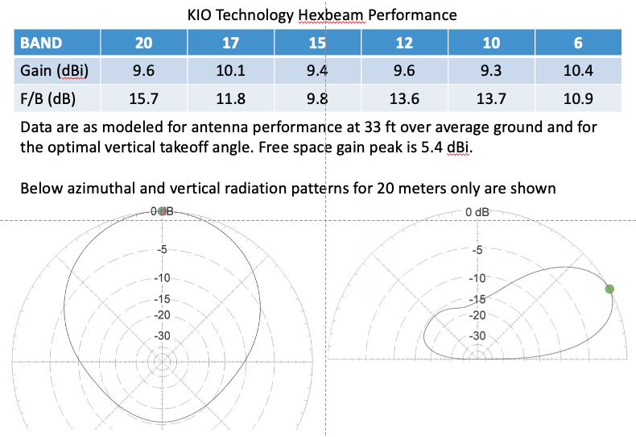
#8. Performance data for a Hex Beam antenna (from K4KIO website).
(Higher number is better.)

Slide 12
#9. Why “free space” seen on earlier slides?
Free space gain is a pretty standard means of comparing antenna forward gain performance. Actual forward gain is higher because the radio wave is reflected off the ground and the reflected wave combines with the direct wave to result in a higher gain at a particular vertical angle. It happens that, if the antenna is 1/2 wavelength above ground, the maximal gain will be angled upward about 30 degrees off the horizontal. But, if the antenna is only 1/4 wavelength above ground, the reflected wave and the direct wave will combine for a resultant radiated lobe that is at a higher angle. This is important because the lower the skip angle, the longer the skip.
The height of the antenna affects its performance obviously. Manufacturers generally use Free space gain (with the units designated dBi, for isotropic gain) to eliminate the need to discuss the height of the antenna. Two antennas with different heights can be compared in a valid manner by referencing the free space gain. Higher number is better. Height is not a factor when talking about free-space-gain nor is ground.

Slide 13
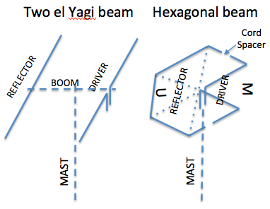
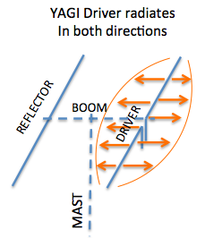
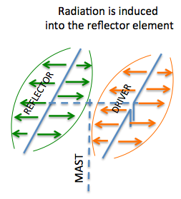
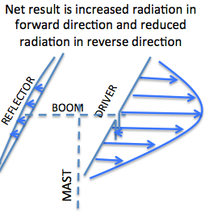
#10a. Explaining why the transmitted signal goes in a concentrated direction.
https://www.k4kio.com/how-does-a-hex-work/

Slide 14
#10b. How it works..a different look; this is copied, with editing, from K4KIO.
So there are two elements radiating; the driver radiates from energy fed directly from the transmission line; the reflector radiates from “received” energy.
The energy waves combine with each other to cancel in the reverse direction and add in the forward direction.
Because of the distance between the driver and the reflector elements, the reflector wave combines with the driven wave in the forward direction (right)
but subtracts from the driver wave in the reverse direction(left). This causes, in the forward direction, a resultant stronger wave than either one of them alone. This is how “gain” is achieved in the forward direction. At the same time, in the reverse direction, the original wave and the reflector’s wave tend to cancel each other with a net result of a reduced RF signal. This is how the “front/back” effect is achieved; a high number is better.
A parasitic beam does not actually generate any new RF energy. It merely results in a focused beam of the original energy fed to the driven element.

Slide 15
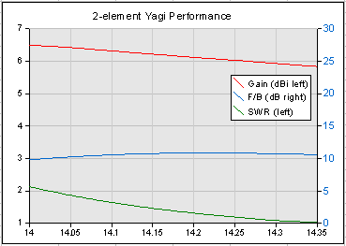
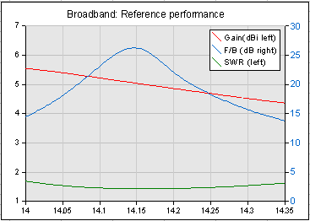
#11. A look at the Hex Beam’s Gain, Front-to-Back ratio (F/B), SWR; we can compare it to a standard 2-element Yagi.
We want high gain, high F/B and low SWR.
Hexbeam performance
As we saw in an earlier slide, where the above came from in year-2024 is now a gambling website.

Slide 16
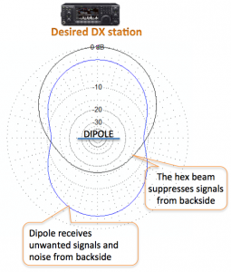
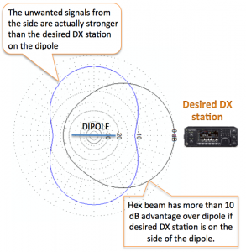
#12. Compare Hex Beam to dipole performance; this is vitally significant.

Slide 17
#13. Talk a bit about mounting height and other considerations about robust construction.
What is the best height for a Hex Beam antenna?
Around 35ft
The Hex Beam works best at heights around 35ft or more but it gives a good account of itself even at 20ft – particularly if it isn't pointing towards any close obstructions. You will see a markedly improved SWR when raised to a reasonable height and away from nearby obstructions such as buildings.
The main differences among Hex Beams are in the physical construction details. How robust is the Hex Beam? How will it fare in salt water environments, wind, snow and ice? Sturdiness and survivability are important and you can make a hex beam like an M1 Abrams tank but what is the cost and is it too heavy to mount on an inexpensive mast or do you have to have a broadcast quality tower to support it? As with all good engineering, it is a matter of balancing cost vs survivability. You can spend huge bucks and get a beam that might withstand a Category 5 hurricane but if you just want one that will stand the weather conditions in 99.9% of the time, you won’t have to pay your retirement nest egg for it.

Slide 18

#14. Balun; material taken from K4KIO website.
Is a Balun Needed?
Yes, a balun is recommended.
All balanced antennas such as dipoles, Yagis and hexbeams that are fed with unbalanced feed lines such as coax, require a choke balun. Without a choke balun, common mode RF currents flow on the outside of the coax making the feedline act like another antenna. The radiated RF power this causes will tend to distort the front/back performance or front/side performance of your hex beam. A simple way to greatly reduce this is by use of a good choke balun.
There are several approaches to a choke balun but we recommend the use of ferrite beads on the coax cable itself. A very inexpensive unit such as the ones we sell are quite effective.
On our hex beams, we recommend that the choke balun be located at top of the center post and physically strapped to the center post with tape or velcro.
Our ferrite bead baluns are available in two different sizes to fit your cable. All of our kits contain five ferrite beads and are generally the same electrically; it’s just a matter of the size of your cable. Make your selection of which size ferrite bead choke balun you need in our store.
Note that the ferrite bead baluns do not require any coax connectors which is a good thing as our experience has shown that coax connectors in the feedline are the most frequent cause of trouble because of the ingress of water that results in corrosion in the cable. The coax connector shown in the photo here should always be wrapped with an appropriate sealant or rubberized tape to keep moisture out of the cable. The photo shows the coax connector without sealant.

Slide 19
#15. A look at some USA manufactures with $$$ too; there are European choices too.
Maker | Model | Price | Other
Radiowavz | Sentinel | $1,000 | 4 Bands (20, 15, 10, 6)
Buddipole | BuddiHex | $749 | 6 Bands
NA4RR | NA4RR Hexagonal beam | $640 | 6 Bands
VHQ Hexbeam | VHQ Hex beam | $1,789 | 6 Bands
KIO Technology | KIO Hex beam | $561 – $891 | 1 – 6 Bands

Slide 20
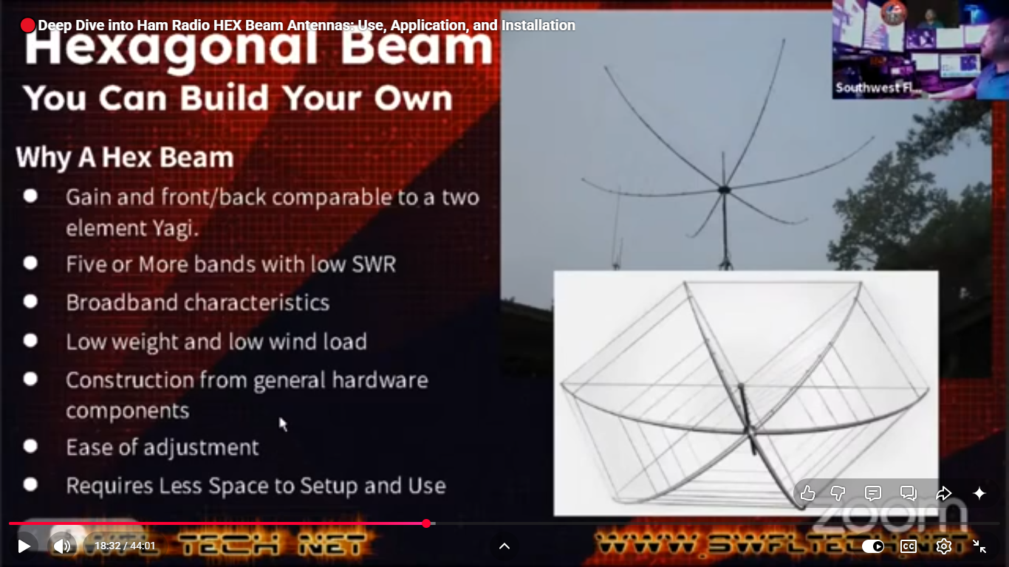
#16. Why a Hex Beam?
YouTube videos claim it can work DX just 6’ or 10’ above ground in a bucket of sand.

Slide 21
#17. https://www.k4kio.com/hex-ed-articles/
Learn more about the amazing hex beam antenna in these Hex Education articles.
How do I trouble shoot my hex beam?
What’s so hot about the hex beam?
What about 40 meters on a hex beam?
Why is a hex beam superior to the dipole?
Which is better; the Spiderbeam or a hex beam?
Why is a hex beam better than a vertical?
How does a hex beam work?
What is the history of the hex beam?
Should I paint my hex beam?
What is a good mast for my hex beam?
What kind of feedline cable do I need?
What’s a thrust bearing and how is it used with a hex beam?
Is SWR really all that important?
Will my hex beam interact with other antennas?
Which Hex Beam works best?
What is the direction of my hex beam?
Does rain on my hex mess it up?

Slide 22
18. Bibliography.
ARRL’s “Handbook” (2011).
ARRL’s “Antenna Handbook”; 21st edition.
Telecon with Leo Shoemaker K4KIO.
http://www.k4kio.com/hexagonal-beam-compared-with-a-dipole/
https://www.k4kio.com/how-does-a-hex-work/#:~:text=A%20parasitic%20beam%20does%20not,shape%20of%20the%20letter%20M.
http://www.w8ji.com/antennas.htm
http://www.voacap.com/antennas/squeezing-decibels-out-of-dipole/
http://www.radio-electronics.com/info/antennas/yagi/yagi.php
https://en.wikipedia.org/wiki/Yagi-Uda_antenna
“Array of Light” by Tom Schiller, N6BT.
https://en.wikipedia.org/wiki/Fall_of_Singapore
https://www.k4kio.com/which-hex-beam-works-best/#:~:text=Which%20hexbeam%20performs%20the%20best%3F,on%20air%20about%20the%20same.
https://www.k4kio.com/is-a-balun-required/#:~:text=Yes%2C%20a%20balun%20is%20recommended,feedline%20act%20like%20another%20antenna.
https://wa4nzd.wordpress.com/2014/10/15/hexagonal-beam-antenna-presentation-by-rob-conklin-n4wgy/
https://www.vhqhex.com/
https://www.g3txq-hexbeam.com/index.php/shop-test/products.html?id=184
Omission of any credit is a regretful and unintended error on my part.

Slide 23
We are at the end; so that’s it, folks.
Questions??
After this slide, there are 9 slides (slide-24 to slide-32) that were considered for this presentation. There is much useful, helpful “Yagi” information there. Also quite interesting. I encourage you to take a look. All, except the last one, were used in the 2024 Yagi PPT.

Slide 24
Dipole-101.
The dipole is the basic building block of many antennas; true for the yagi-uda.
A dipole, in free-space, has 2.15dBi gain over an isotropic radiator, which is a theoretical antenna in free-space.
The notion a dipole has around 2.15 dBi gain is only true for free-space.
But, bringing that dipole down to one wave-length over good ground, it now has about 8 dB gain over an isotropic radiator.
8dB ~= 2.15dBi + 3dB from putting it over ground + 3dB from ground reflection gain.
Always remember this thought when you see antenna-gain over earth given in dBi;
“If any antenna over earth shows a ‘gain’ of about 8 dBi, its gain is doing no better than a dipole.”
That said, it may have other redeeming qualities as we have seen on the previous slide.
(The above material is adapted from websites by W8JI & OH6BG.)

Slide 25
What are the names of its parts?
The Yagi-Uda antenna design has a dipole as the main radiating or driven-element. Another name you may see or hear used for this part is “driver”.
‘Parasitic-elements’ called “reflector” and “director” are added, which are not directly connected to the driven element.
The boom, of necessity, must be structurally sound and so is typically conductive metal; the boom is electrically at ground potential.
The yagi shown above has four elements… one “reflector”, one “driver”, and two “directors” and so is called a “four-element yagi”.

Slide 26
How it works..a different look; this is copied, with editing, from K4KIO.
A two element Yagi has a driver and a reflector made of aluminum tubing that is mounted on a boom and supported by a mast.
Basically, the driven element configured as a dipole radiates
in both directions broadside to its axis as shown in orange.
When the RF wave strikes the reflector element,
it induces current in the reflector causing it to radiate also in both directions (green).

Slide 27
Finally….how it works.
We need to talk about some basic stuff here to get ready for the next slide. 1. This #1 has nothing to do with a yagi…just leading up to something. Lets say we have a resistor connected across a battery’s terminals. Direct-current (DC) will flow thru that resistor and its wires. The electrons in direct-current move in one direction, namely from the battery’s negative-terminal thru the resistor to the battery’s positive-terminal. Those moving electrons are making something special happen. There is a magnetic-field around the wire…it is static…fixed in position and time.
2. Lets now replace that battery with Alternating-Current (AC), say at 7 MHz.
Now our electrons are moving back and forth (a tiny distance) at 7 million cycles per second. The electrons will speed up, slow down to stop, speed up to go the other way, slow to stop, etc. To do this, our electrons accelerate and de-celebrate to a stop, then change direction.
As before, there will be a magnetic-field around each wire but this time, as the electrons accelerate and de-celerate, the magnetic-field changes too.
3. Here the key to our hobby…the electro-magnetic wave:
3a. That changing magnetic-field has a companion…it makes a changing electric-field.
3b. That changing electric-field causes a changing magnetic-field. 3c. That’s what makes our hobby possible…that’s propagation.

Slide 28
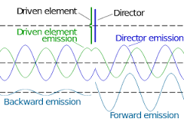
Graduate course….how it works.
1. The “driven-element” radiates a signal as a dipole; call this the “main-signal”.
2. A very short time later, each “parasitic-element” receives that signal and current flows in it.
3. When the current in a “parasitic” reaches the boom (remember there is a short circuit there),
that alternating-current is reflected up the “parasitic” since it is a shorted transmission-line,.
4. Each parasitic-element is now acting like a driven-element and radiates its own signal, albeit ever so slightly later in time to that of the driven-element.
5. Adding up the two signals, the “main-signal” is both cancelled out and reinforced.
6. Research shows that the amplitude and phase of the alternating-current that is induced in a parasitic element is dependent upon its length and the spacing between it and the dipole.

Slide 29
The bandwidth of an antenna is defined as the width of the band of frequencies having a gain within 3 dB (one-half the power) of its maximum gain.
The Yagi–Uda array in its basic form has very narrow bandwidth, 2–3 percent of the center frequency, which is still pretty decent. You could QSY quite a bit there.
There is a tradeoff between gain and bandwidth, with the bandwidth narrowing as more elements are used for more gain.
Multi-band yagi are sold but performance suffers over a single band yagi.

Slide 30
What are its negative qualities for HF?
1. Antenna’s cost….can be quite expensive.
2. Usually need a tower...more expense.
3. May need Professional Engineer for soil-test…think here about Leaning Tower of Pisa.
4. Need space for big booms.
5. Big wind and ice loading.
6. Slow to rotate into position if there is a ‘spot’ to which you want to make a QSO and you are not aimed that way.
7. As mentioned earlier, the yagi’s impedance is low….10 to 40 ohms typically, so matching can be challenging.

Slide 31
Short story how it came to be.
Between the two World-Wars, Dr. Shintaro Uda, assisted by Dr. Hidetsugu Yagi,
developed a “proof-of-concept” for this antenna.
The engineering details proved to be quite difficult.
Later, Yagi translated the work into English and it was published.
During WWII, the Japanese won the Battle of Singapore (February 1942; the largest British surrender in its history) and interrogated a captured British radar-technician about some of his notes that mentioned a Yagi antenna.
That was the first the Japanese military learned about this antenna.
However the British, Americans and the Germans made extensive use of the Yagi antenna during that war.
Dr. Yagi always attributed the design to Dr. Uda.

Slide 32
https://www.k4kio.com/hexagonal-beam-vs-spiderbeam/#:~:text=So%20the%20Spider%20beam%20is,are%20in%20for%20some%20work.
the Spider beam is going to have a bit more gain on several bands than a hex. The two weigh about the same but the Spider beam is about 33 feet across at its widest point compared with 22 feet for the hex. If you buy a Spider beam, you are in for some work.Sep 20, 2015

